Slide 1
How to Encode Instructions?

Slide 2
How to Encode Instructions?
Design Principle 1: Regularity supports design simplicity
  32-bit data, 32-bit instructions
  For design simplicity, would prefer a single instruction format but…

Slide 3
How to Encode Instructions?
Design Principle 1: Regularity supports design simplicity
  32-bit data, 32-bit instructions
  For design simplicity, would prefer a single instruction format but…
  Instructions have different needs

Slide 4
Design Principle 4
Good design demands good compromises
Multiple instruction formats allow flexibility
  ADD, SUB: use 3 register operands
  LDR, STR: use 2 register operands and a constant
Number of instruction formats kept small
  to adhere to design principles 1 and 3 (regularity supports design simplicity and smaller is faster)

Slide 5
Machine Language
Binary representation of instructions
Computers only understand 1’s and 0’s
32-bit instructions
  Simplicity favors regularity: 32-bit data & instructions
3 instruction formats:
  Data-processing
  Memory
  Branch

Slide 6
Instruction Formats
Data-processing
Memory
Branch

Slide 7
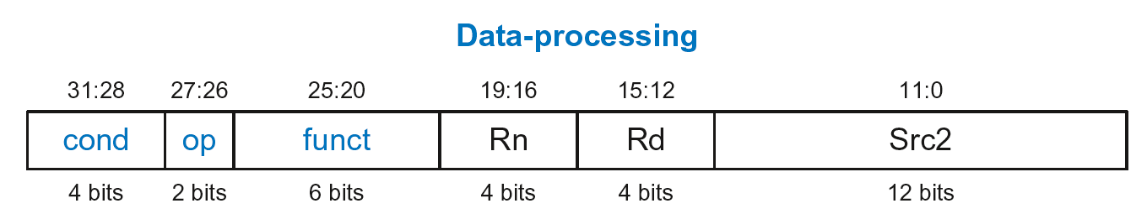
Data-processing Instruction Format
Operands:
  Rn: first source register
  Src2: second source – register or immediate
  Rd: destination register
Control fields:
  cond: specifies conditional execution
  op: the operation code or opcode
  funct: the function/operation to perform

Slide 8
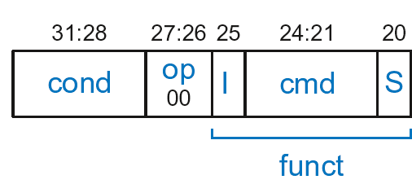
Data-processing Control Fields
op = 00₂ for data-processing (DP) instructions
funct is composed of cmd, I-bit, and S-bit

Slide 9
Data-processing Control Fields
op = 00₂ for data-processing (DP) instructions
funct is composed of cmd, I-bit, and S-bit
  cmd: specifies the specific data-processing instruction. For example,
    cmd = 0100₂ for ADD
    cmd = 0010₂ for SUB
  I-bit
    I = 0: Src2 is a register
    I = 1: Src2 is an immediate
  S-bit: 1 if sets condition flags
    S = 0: SUB R0, R5, R7
    S = 1: ADDS R8, R2, R4 or CMP R3, #10

Slide 10
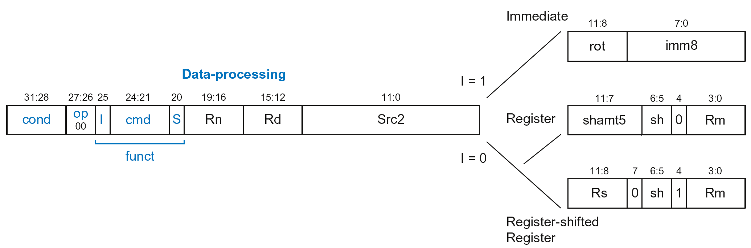
Data-processing Src2 Variations
Src2 can be:
  Immediate
  Register
  Register-shifted register

Slide 11
Data-processing Src2 Variations
Src2 can be:
  Immediate
  Register
  Register-shifted register

Slide 12
Immediate Src2
Immediate encoded as:
  imm8: 8-bit unsigned immediate
  rot: 4-bit rotation value
32-bit constant is: imm8 ROR (rot × 2)

Slide 13
Immediate Src2
Immediate encoded as:
  imm8: 8-bit unsigned immediate
  rot: 4-bit rotation value
32-bit constant is: imm8 ROR (rot × 2)
Example: imm8 = abcdefgh
rot | 32-bit constant
0000 | 0000 0000 0000 0000 0000 0000 abcd efgh
0001 | gh00 0000 0000 0000 0000 0000 00ab cdef
… | …
1111 | 0000 0000 0000 0000 0000 00ab cdef gh00

Slide 14
Immediate Src2
Immediate encoded as:
  imm8: 8-bit unsigned immediate
  rot: 4-bit rotation value
32-bit constant is: imm8 ROR (rot × 2)
Example: imm8 = abcdefgh
ROR by X = ROL by (32-X)
Ex: ROR by 30 = ROL by 2
rot | 32-bit constant
0000 | 0000 0000 0000 0000 0000 0000 abcd efgh
0001 | gh00 0000 0000 0000 0000 0000 00ab cdef
… | …
1111 | 0000 0000 0000 0000 0000 00ab cdef gh00

Slide 15
DP Instruction with Immediate Src2
  ADD R0, R1, #42
        cond = 1110₂ (14) for unconditional execution
        op = 00₂ (0) for data-processing instructions
        cmd = 0100₂ (4) for ADD
        Src2 is an immediate so I = 1
        Rd = 0, Rn = 1
        imm8 = 42, rot = 0

Slide 16
DP Instruction with Immediate Src2
  ADD R0, R1, #42
        cond = 1110₂ (14) for unconditional execution
        op = 00₂ (0) for data-processing instructions
        cmd = 0100₂ (4) for ADD
        Src2 is an immediate so I = 1
        Rd = 0, Rn = 1
        imm8 = 42, rot = 0
0xE281002A

Slide 17
DP Instruction with Immediate Src2
  SUB R2, R3, #0xFF0
  cond = 1110₂ (14) for unconditional execution
  op = 00₂ (0) for data-processing instructions
  cmd = 0010₂ (2) for SUB
  Src2 is an immediate so I=1
  Rd = 2, Rn = 3
  imm8 = 0xFF
  imm8 must be rotated right by 28 to produce 0xFF0, so rot = 14
ROR by 28 =
ROL by (32-28) = 4
0xE2432EFF

Slide 18
DP Instruction with Register Src2
Src2 can be:
  Immediate
  Register
  Register-shifted register

Slide 19
DP Instruction with Register Src2
Rm: the second source operand
shamt5: the amount Rm is shifted
sh: the type of shift (i.e., >>, <<, >>>, ROR)

Slide 20
DP Instruction with Register Src2
Rm: the second source operand
shamt5: the amount Rm is shifted
sh: the type of shift (i.e., >>, <<, >>>, ROR)
  First, consider unshifted versions of Rm (shamt5=0, sh=0)

Slide 21
DP Instruction with Register Src2
  ADD R5, R6, R7
  cond = 1110₂ (14) for unconditional execution
  op = 00₂ (0) for data-processing instructions
  cmd = 0100₂ (4) for ADD
  Src2 is a register so I=0
  Rd = 5, Rn = 6, Rm = 7
  shamt = 0, sh = 0
0xE0865007

Slide 22
DP Instruction with Register Src2
Rm: the second source operand
shamt5: the amount Rm is shifted
sh: the type of shift
Shift Type | sh
LSL | 00₂
LSR | 01₂
ASR | 10₂
ROR | 11₂
  Now, consider shifted versions.

Slide 23
DP Instruction with Register Src2
  ORR R9, R5, R3, LSR #2
  Operation: R9 = R5 OR (R3 >> 2)
  cond = 1110₂ (14) for unconditional execution
  op = 00₂ (0) for data-processing instructions
  cmd = 1100₂ (12) for ORR
  Src2 is a register so I=0
  Rd = 9, Rn = 5, Rm = 3
  shamt5 = 2, sh = 01₂ (LSR)
  1110 00 0 1100 0 0101 1001 00010 01 0 0011
  0xE1859123

Slide 24
DP with Register-shifted Reg. Src2
Src2 can be:
  Immediate
  Register
  Register-shifted register

Slide 25
DP with Register-shifted Reg. Src2
  EOR R8, R9, R10, ROR R12
  Operation: R8 = R9 XOR (R10 ROR R12)
  cond = 1110₂ (14) for unconditional execution
  op = 00₂ (0) for data-processing instructions
  cmd = 0001₂ (1) for EOR
  Src2 is a register so I=0
  Rd = 8, Rn = 9, Rm = 10, Rs = 12
  sh = 11₂ (ROR)
  1110 00 0 0001 0 1001 1000 1100 0 11 1 1010
  0xE0298C7A

Slide 26
Shift Instructions Encoding
Shift Type | sh
LSL | 00₂
LSR | 01₂
ASR | 10₂
ROR | 11₂

Slide 27
Shift Instructions: Immediate shamt
  ROR R1, R2, #23
  Operation: R1 = R2 ROR 23
  cond = 1110₂ (14) for unconditional execution
  op = 00₂ (0) for data-processing instructions
  cmd = 1101₂ (13) for all shifts (LSL, LSR, ASR, and ROR)
  Src2 is an immediate-shifted register so I=0
  Rd = 1, Rn = 0, Rm = 2
  shamt5 = 23, sh = 11₂ (ROR)
  1110 00 0 1101 0 0000 0001 10111 11 0 0010
  0xE1A01BE2

Slide 28
Shift Instructions: Immediate shamt
  ROR R1, R2, #23
  Operation: R1 = R2 ROR 23
  cond = 1110₂ (14) for unconditional execution
  op = 00₂ (0) for data-processing instructions
  cmd = 1101₂ (13) for all shifts (LSL, LSR, ASR, and ROR)
  Src2 is an immediate-shifted register so I=0
  Rd = 1, Rn = 0, Rm = 2
  shamt5 = 23, sh = 11₂ (ROR)
Uses (immediate-shifted) register Src2 encoding
  1110 00 0 1101 0 0000 0001 10111 11 0 0010
  0xE1A01BE2

Slide 29
Shift Instructions: Register shamt
  ASR R5, R6, R10
  Operation: R5 = R6 >>> R10_{7:0}
  cond = 1110₂ (14) for unconditional execution
  op = 00₂ (0) for data-processing instructions
  cmd = 1101₂ (13) for all shifts (LSL, LSR, ASR, and ROR)
  Src2 is a register so I=0
  Rd = 5, Rn = 0, Rm = 6, Rs = 10
  sh = 10₂ (ASR)
  1110 00 0 1101 0 0000 0101 1010 0 10 1 0110
  0xE1A05A56

Slide 30
Shift Instructions: Register shamt
  ASR R5, R6, R10
  Operation: R5 = R6 >>> R10_{7:0}
  cond = 1110₂ (14) for unconditional execution
  op = 00₂ (0) for data-processing instructions
  cmd = 1101₂ (13) for all shifts (LSL, LSR, ASR, and ROR)
  Src2 is a register so I=0
  Rd = 5, Rn = 0, Rm = 6, Rs = 10
  sh = 10₂ (ASR)
Uses register-shifted register Src2 encoding
  1110 00 0 1101 0 0000 0101 1010 0 10 1 0110
  0xE1A05A56

Slide 31
Review: Data-processing Format
Src2 can be:
  Immediate
  Register
  Register-shifted register

Slide 32
Instruction Formats
Data-processing
Memory
Branch

Slide 33
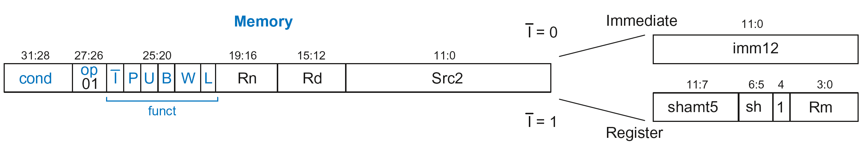
Memory Instruction Format
Encodes: LDR, STR, LDRB, STRB
op = 01₂
Rn = base register
Rd = destination (load), source (store)
Src2 = offset
funct = 6 control bits

Slide 34
Offset Options
Recall: Address = Base Address + Offset
  Example: LDR R1, [R2, #4]
  Base Address = R2, Offset = 4
  Address = (R2 + 4)
Base address always in a register
The offset can be:
  an immediate
  a register
  or a scaled (shifted) register

Slide 35
Offset Examples
ARM Assembly | Memory Address
LDR R0, [R3, #4] | R3 + 4
LDR R0, [R5, #-16] | R5 – 16
LDR R1, [R6, R7] | R6 + R7
LDR R2, [R8, -R9] | R8 – R9
LDR R3, [R10, R11, LSL #2] | R10 + (R11 << 2)
LDR R4, [R1, -R12, ASR #4] | R1 – (R12 >>> 4)
LDR R0, [R9] | R9

Slide 36
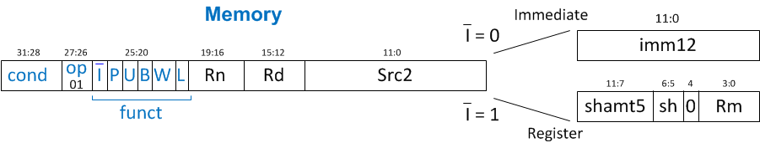
Memory Instruction Format
Encodes: LDR, STR, LDRB, STRB
op = 01₂
Rn = base register
Rd = destination (load), source (store)
Src2 = offset: register (optionally shifted) or immediate
funct = 6 control bits

Slide 37
Indexing Modes
Mode | Address | Base Reg. Update
Offset | Base register ± Offset | No change
Preindex | Base register ± Offset | Base register ± Offset
Postindex | Base register | Base register ± Offset
Examples
Offset: LDR R1, [R2, #4] ; R1 = mem[R2+4]
Preindex: LDR R3, [R5, #16]! ; R3 = mem[R5+16]
; R5 = R5 + 16
Postindex: LDR R8, [R1], #8 ; R8 = mem[R1]
    ; R1 = R1 + 8

Slide 38
Memory Instruction Format
funct:
  I: Immediate bar
  P: Preindex
  U: Add
  B: Byte
  W: Writeback
  L: Load

Slide 39
Memory Format funct Encodings
Type of Operation
L | B | Instruction
0 | 0 | STR
0 | 1 | STRB
1 | 0 | LDR
1 | 1 | LDRB

Slide 40
Memory Format funct Encodings
Type of Operation
Indexing Mode
L | B | Instruction
0 | 0 | STR
0 | 1 | STRB
1 | 0 | LDR
1 | 1 | LDRB
P | W | Indexing Mode
0 | 1 | Not supported
0 | 0 | Postindex
1 | 0 | Offset
1 | 1 | Preindex

Slide 41
Memory Format funct Encodings
Type of Operation
Indexing Mode
L | B | Instruction
0 | 0 | STR
0 | 1 | STRB
1 | 0 | LDR
1 | 1 | LDRB
P | W | Indexing Mode
0 | 1 | Not supported
0 | 0 | Postindex
1 | 0 | Offset
1 | 1 | Preindex
Add/Subtract Immediate/Register Offset
Value | I | U
0 | Immediate offset in Src2 | Subtract offset from base
1 | Register offset in Src2 | Add offset to base

Slide 42
Memory Instruction Format
Encodes: LDR, STR, LDRB, STRB
op = 01₂
Rn = base register
Rd = destination (load), source (store)
Src2 = offset: immediate or register (optionally shifted)
funct = I (immediate bar), P (preindex), U (add),
B (byte), W (writeback), L (load)

Slide 43
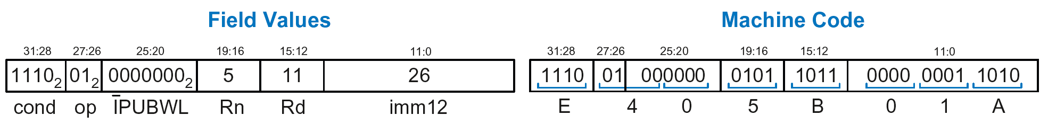
Memory Instr. with Immediate Src2
  STR R11, [R5], #-26
  Operation: mem[R5] <= R11; R5 = R5 - 26
  cond = 1110₂ (14) for unconditional execution
  op = 01₂ (1) for memory instruction
  funct = 0000000₂ (0)
  I = 0 (immediate offset), P = 0 (postindex),
  U = 0 (subtract), B = 0 (store word), W = 0 (postindex),
  L = 0 (store)
  Rd = 11, Rn = 5, imm12 = 26

Slide 44
Memory Instr. with Register Src2
  LDR R3, [R4, R5]
  Operation: R3 <= mem[R4 + R5]
  cond = 1110₂ (14) for unconditional execution
  op = 01₂ (1) for memory instruction
  funct = 111001₂ (57)
  I = 1 (register offset), P = 1 (offset indexing),
  U = 1 (add), B = 0 (load word), W = 0 (offset indexing),
  L = 1 (load)
  Rd = 3, Rn = 4, Rm = 5 (shamt5 = 0, sh = 0)
  1110 01 111001 0100 0011 00000 00 0 0101 = 0xE7943005

Slide 45
Memory Instr. with Scaled Reg. Src2
  STR R9, [R1, R3, LSL #2]
  Operation: mem[R1 + (R3 << 2)] <= R9
  cond = 1110₂ (14) for unconditional execution
  op = 01₂ (1) for memory instruction
  funct = 111000₂ (0)
  I = 1 (register offset), P = 1 (offset indexing),
  U = 1 (add), B = 0 (store word), W = 0 (offset indexing),
  L = 0 (store)
  Rd = 9, Rn = 1, Rm = 3, shamt = 2, sh = 00₂ (LSL)
  1110 01 111000 0001 1001 00010 00 0 0011 = 0xE7819103

Slide 46
Review: Memory Instruction Format
Encodes: LDR, STR, LDRB, STRB
op = 01₂
Rn = base register
Rd = destination (load), source (store)
Src2 = offset: register (optionally shifted) or immediate
funct = I (immediate bar), P (preindex), U (add),
B (byte), W (writeback), L (load)

Slide 47
Instruction Formats
Data-processing
Memory
Branch

Slide 48
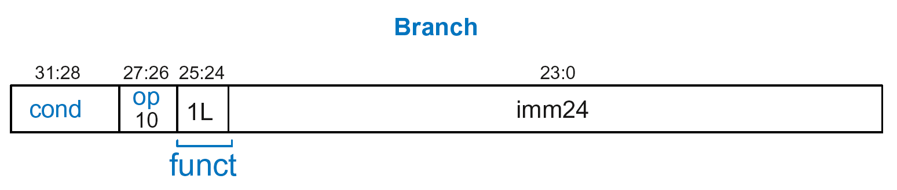
Branch Instruction Format
Encodes B and BL
op = 10₂
imm24: 24-bit immediate
funct = 1L₂: L = 1 for BL, L = 0 for B

Slide 49
Encoding Branch Target Address
Branch Target Address (BTA): Next PC when branch taken
BTA is relative to current PC + 8
imm24 encodes BTA
imm24 = # of words BTA is away from PC+8

Slide 50
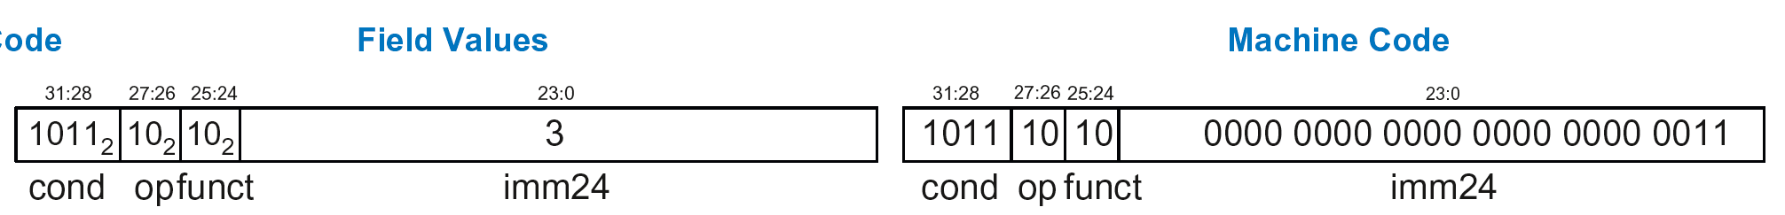
Branch Instruction: Example 1
ARM assembly code
0xA0 BLT THERE
0xA4 ADD R0, R1, R2
0xA8 SUB R0, R0, R9
0xAC ADD SP, SP, #8
0xB0 MOV PC, LR
0xB4 THERE SUB R0, R0, #1
0xB8 BL TEST
PC
PC = 0xA0
PC + 8 = 0xA8
THERE label is 3 instructions past PC+8
So, imm24 = 3
PC+8
BTA
0xBA000003

Slide 51
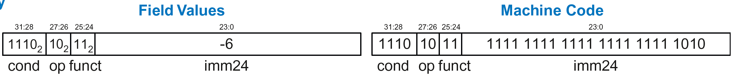
Branch Instruction: Example 2
ARM assembly code
0x8040 TEST LDRB R5, [R0, R3]
0x8044 STRB R5, [R1, R3]
0x8048 ADD R3, R3, #1
0x8044 MOV PC, LR
0x8050 BL TEST
0x8054 LDR R3, [R1], #4
0x8058 SUB R4, R3, #9
BTA
PC = 0x8050
PC + 8 = 0x8058
TEST label is 6 instructions before PC+8
So, imm24 = -6
PC
PC+8
0xEBFFFFFA

Slide 52

Review: Instruction Formats

Slide 53
Conditional Execution
Encode in cond bits of machine instruction
  For example,
  ANDEQ R1, R2, R3 (cond = 0000)
  ORRMI R4, R5, #0xF (cond = 0100)
  SUBLT R9, R3, R8 (cond = 1011)

Slide 54
Review: Condition Mnemonics

Slide 55
Conditional Execution: Machine Code

Slide 56
Interpreting Machine Code
Start with op: tells how to parse rest
    op = 00 (Data-processing)
    op = 01 (Memory)
    op = 10 (Branch)
I-bit: tells how to parse Src2
Data-processing instructions:
    If I-bit is 0, bit 4 determines if Src2 is a register (bit 4 = 0) or a register-shifted register (bit 4 = 1)
Memory instructions:
    Examine funct bits for indexing mode, instruction, and add or subtract offset

Slide 57
Interpreting Machine Code: Example 1
0xE0475001

Slide 58
Interpreting Machine Code: Example 1
0xE0475001
  Start with op: 00₂, so data-processing instruction

Slide 59
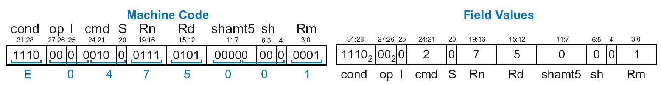
Interpreting Machine Code: Example 1
0xE0475001
  Start with op: 00₂, so data-processing instruction
  I-bit: 0, so Src2 is a register
  bit 4: 0, so Src2 is a register (optionally shifted by shamt5)

Slide 60
Interpreting Machine Code: Example 1
0xE0475001
  Start with op: 00₂, so data-processing instruction
  I-bit: 0, so Src2 is a register
  bit 4: 0, so Src2 is a register (optionally shifted by shamt5)
  cmd: 0010₂ (2), so SUB
  Rn=7, Rd=5, Rm=1, shamt5 = 0, sh = 0
  So, instruction is: SUB R5,R7,R1

Slide 61
Interpreting Machine Code: Example 2
0xE5949010

Slide 62
Interpreting Machine Code: Example 2
0xE5949010
  Start with op: 01₂, so memory instruction
  funct: B=0, L=1, so LDR; P=1, W=0, so offset indexing;
  I=0, so immediate offset, U=1, so add offset
  Rn=4, Rd=9, imm12 = 16
  So, instruction is: LDR R9,[R4,#16]

